Slide 1


CMR TECHNICAL CAMPUS
UGC(Autonomous)
Kandlakoya,Medchal Road,Hyd-501 401 Department of Computer Science Engineering
Major Project On
Generating Synthetic Images from Text using RNN & CNN
BATCH NO : 16
Project Guide: BATCH MEMBERS:
B.P. Deepak Kumar 217R1A0577 B.MANUSHA
Assistant Professor, CSE Department 217R1A05B3 P. SAI KUMAR
217R1A05B5 P. ABHINAV
Project Coordinator:
Dr. J. Narasimharao
Associate Professor, CSE Department

Slide 2
TABLE OF CONTENTS
Use Case Diagram
Class Diagram
Sequence Diagram
Activity Diagram
Results
Conclusion
Future Scope
References
Github Link
Abstract
Existing System
Disadvantages
Proposed System
Advantages
Hardware and Software Requirements
Novelty of the Project
Architecture
Modules

Slide 3
ABSTRACT
The abstract discusses a method for creating synthetic images from text descriptions using a combination of Recurrent Neural Networks (RNN) and Convolutional Neural Networks (CNN). The RNN processes the text input to understand the context and features described, while the CNN generates corresponding images based on this information. This approach leverages the strengths of both neural network types: RNNs excel at handling sequential data like text, and CNNs are effective for image generation. The result is a system capable of transforming written descriptions into visual representations, bridging the gap between language and imagery.

Slide 4
EXISTING SYSTEM
Text-to-image generation has evolved significantly, driven by advancements in deep learning and neural network architectures. This section reviews the current systems and technologies utilized for generating images from textual descriptions, focusing on their architectures, methodologies, and performance metrics.
Generative Adversarial Networks (GANs) for Text-to-Image Generation
Generative Adversarial Networks (GANs) have become a prominent approach in text-to-image synthesis. In this framework, a generator creates images based on textual descriptions, while a discriminator evaluates the authenticity of the generated images in relation to the text.
Architecture
Methodology
Performance Metrics

Slide 5
DISADVANTAGES
Limited Text Comprehension
Low Image Resolution
Challenges in Generating High-Quality Images
High Computational Cost

Slide 6
PROPOSED SYSTEM
The proposed system integrates Recurrent Neural Networks (RNNs) for text embedding with Convolutional Neural Networks (CNNs) for image synthesis to enhance the capabilities of text-to-image generation. This hybrid approach aims to address the limitations of existing systems by improving text comprehension, generating higher-resolution images, and optimizing computational efficiency. This section describes the architecture, data flow, and key innovations of the proposed system.

Slide 7
ADVANTAGES
Improved Image Quality
Better Text Understanding.
Faster Processing Times.
Higher Adaptability to Different Domains
Enhanced User Experience

Slide 8
SYSTEM REQUIREMENTS
HARDWARE REQUIREMENTS
For developing the application the following are the hardware requirements
System Processor : intel i3 or above
Hard Disk : 4 GB (min)
RAM : 20 GB

Slide 9
SOFTWARE REQUIREMENTS
For developing the application the following are the software requirements
Operating System : Windows 7
Coding Language : Python

Slide 10
NOVELTY OF PROJECT
The project's novelty lies in its unique combination of RNNs and CNNs to create images from text. This approach allows the system to better understand and translate detailed language into visuals, producing high-quality images that reflect the nuances of the descriptions. It enhances the ability to generate images accurately and opens new possibilities for applications in art, design, and more. This project lies in its innovative approach to bridging the gap between textual descriptions and visual content.

Slide 11
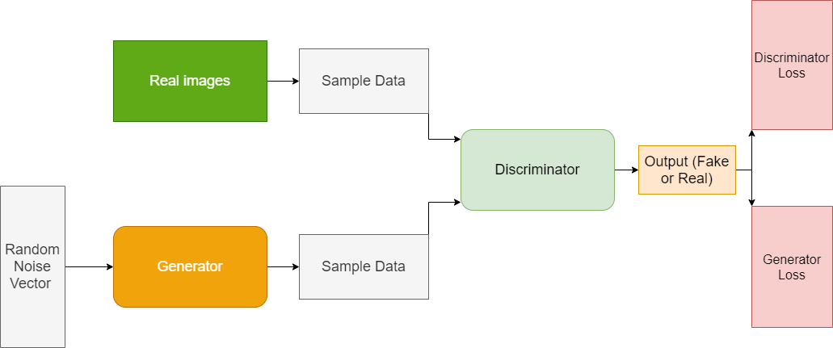
ARCHITECTURE:
Figure : Architecture for Generating Synthetic Images from Text using RNN & CNN

Slide 12
MODULES:
Text Embedding Module: Utilizes an RNN to encode textual descriptions into a feature vector representation.
Image Synthesis Module: Employs a CNN to generate images based on the embedded text features.
Attention Mechanism: Integrates an attention mechanism to refine text-image alignment and improve image quality.

Slide 13
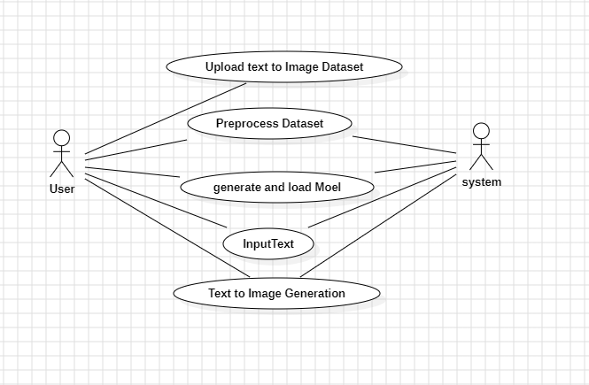
Use Case Diagram:
Figure : Use case Diagram for Generating Synthetic Images from Text using RNN & CNN

Slide 14
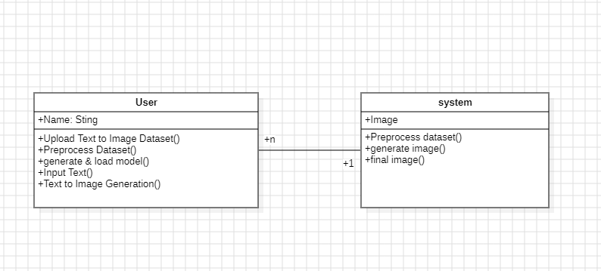
Class Diagram:
Figure : Class Diagram Generating Synthetic Images from Text using RNN & CNN

Slide 15
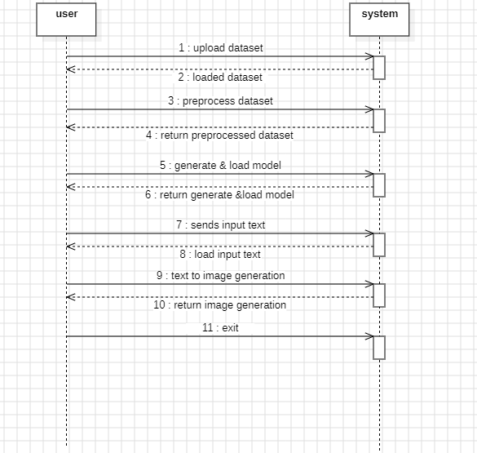




Sequence Diagram:
Figure : Sequence Diagram for Generating Synthetic Images from Text using RNN & CNN

Slide 16
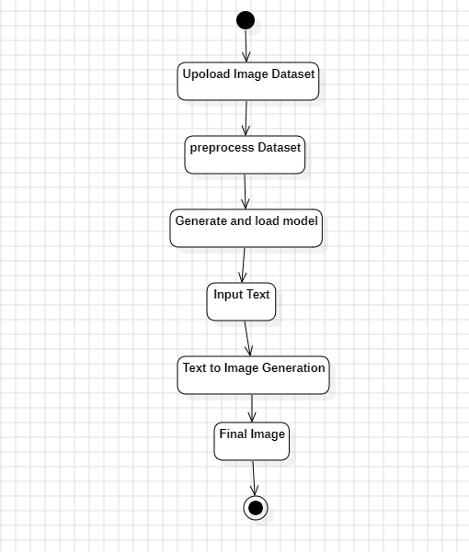
Activity Diagram:
Figure : Activity Diagram Generating Synthetic Images from Text using RNN & CNN

Slide 17
SAMPLE CODE:
from tkinter import *
import tkinter
from tkinter import filedialog
import matplotlib.pyplot as plt
from tkinter.filedialog
import askopenfilename
import numpy as np
import pickle
import cv2
import numpy as np
from sklearn.preprocessing

Slide 18
import StandardScaler
from sklearn.model_selection
import train_test_split
from sklearn.feature_extraction.text
import TfidfVectorizer #loading tfidf vector
from keras.models
import Sequentialfrom keras.layers
import Dense, Flatten, Bidirectional, LSTM, RepeatVector, Dropout
main = tkinter.Tk()
main.title("Generating Synthetic Images from Text using RNN & CNN")
main.geometry("1200x1200")global X_train, X_test, y_train, y_test, tfidf_vectorizer, sc
global modelglobal filename
global X, Y, dataset
stop_words = set(stopwords.words('english'))lemmatizer = WordNetLemmatizer()ps = PorterStemmer()

Slide 19
#define function to clean text by removing stop words and other special symbols
def cleanText(doc): tokens = doc.split()
table = str.maketrans('', '', punctuation)
tokens = [w.translate(table) for w in tokens]
tokens = [word for word in tokens if word.isalpha()]
tokens = [w for w in tokens if not w in stop_words]
tokens = [word for word in tokens if len(word) > 1]
tokens = [ps.stem(token) for token in tokens]
tokens = [lemmatizer.lemmatize(token) for token in tokens]
tokens = ' '.join(tokens) return tokens
def uploadDataset():
global filename, dataset text.delete('1.0', END)
filename = filedialog.askdirectory(initialdir=".")

Slide 20
def preprocessDataset():
global filename, dataset, X, Y, tfidf_vectorizer, sc
global X_train, X_test, y_train, y_test
def predictImage():
global model, sc, tfidf_vectorizer text.delete('1.0', END)
input_text = tf1.get() tf1.delete(0, END)
answer = input_text.lower().strip()
data = answer data = cleanText(data)
test = tfidf_vectorizer.transform([data]).toarray()
test = sc.transform(test)
test = np.reshape(test, (test.shape[0], test.shape[1], 1, 1))
predict = model.predict(test)
predict = predict[0]
predict = np.reshape(predict, (128, 128, 3))
predict = cv2.resize(predict, (300, 300))
cv2.imshow("Text To Image Output", predict) cv2.waitKey(0)

Slide 21
def graph():
accuracy, loss = values("model/history.pckl", "accuracy", "loss")
plt.figure(figsize=(7,5))
plt.grid(True)
font1 = ('times', 13, 'bold’)
uploadButton = Button(main, text="Upload Flickr Text to Image Dataset", command=uploadDataset)
uploadButton.place(x=50,y=100)
uploadButton.config(font=font1)
l1 = Label(main, text='Input Text:’)
l1.config(font=font)
l1.place(x=50,y=200)
main.config(bg='LightSteelBlue1’)
main.mainloop()

Slide 22
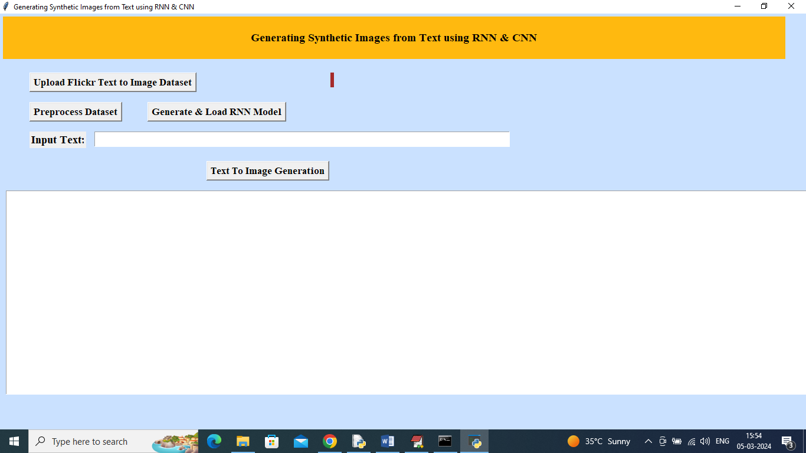
RESULTS:

Slide 23
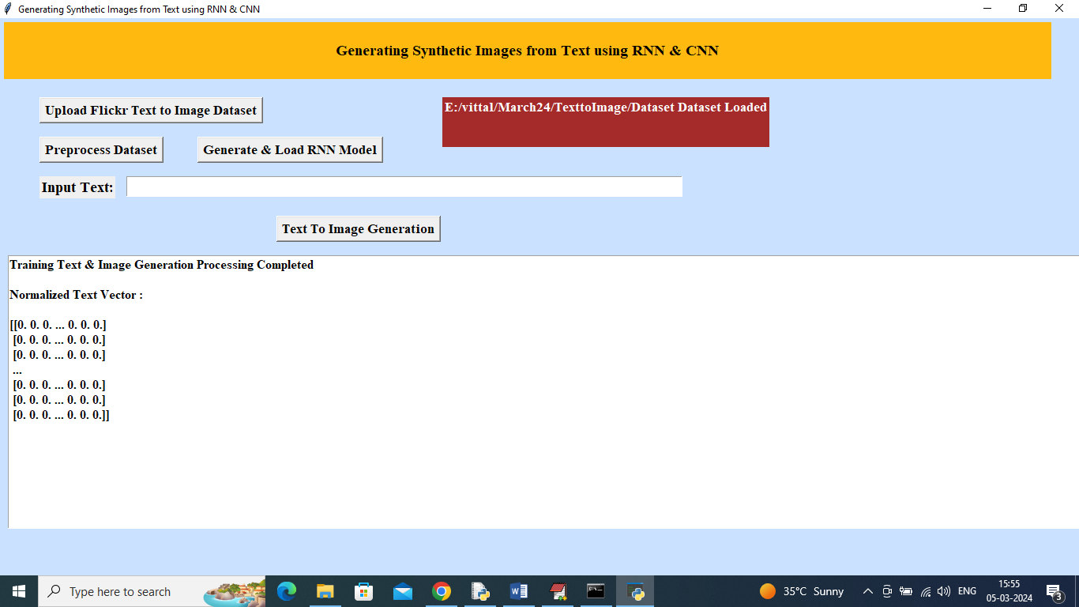

Slide 24
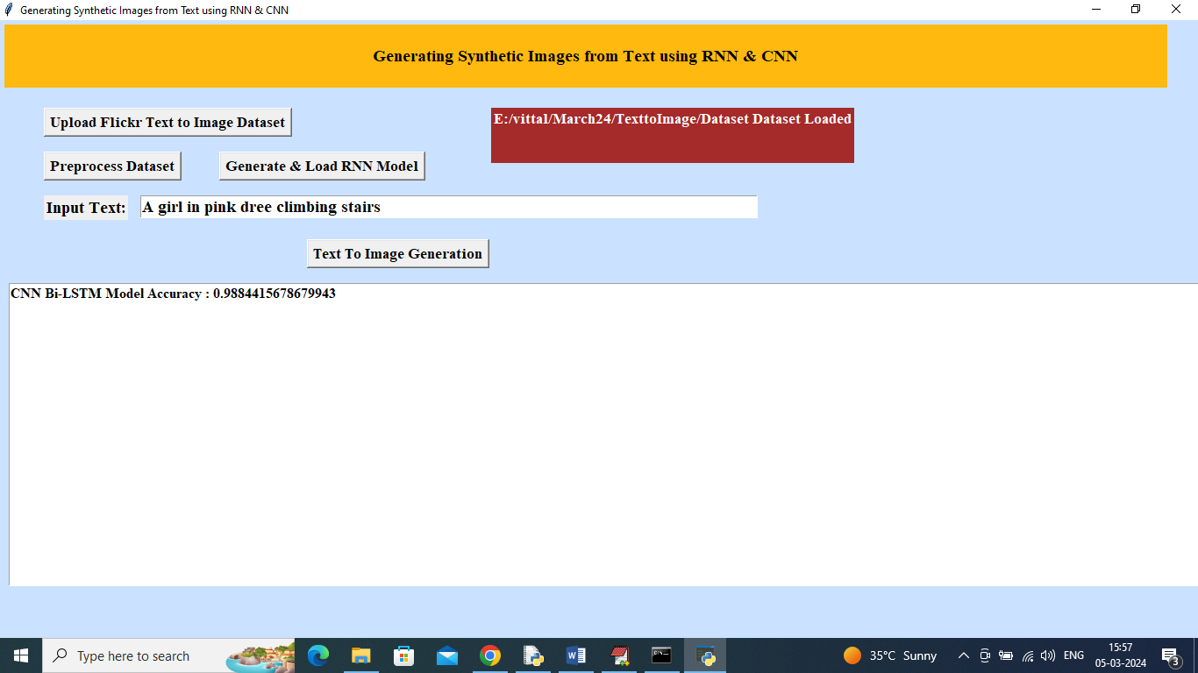

Slide 25
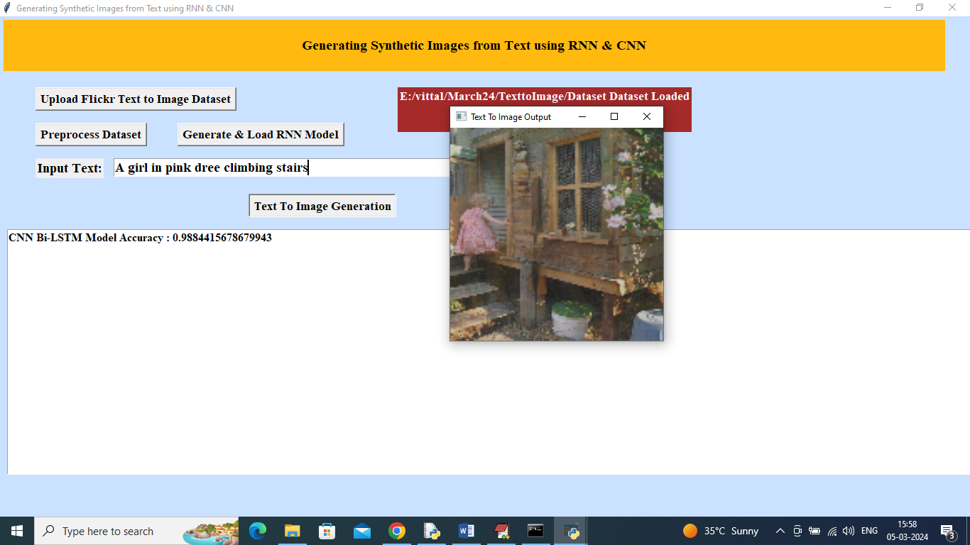

Slide 26
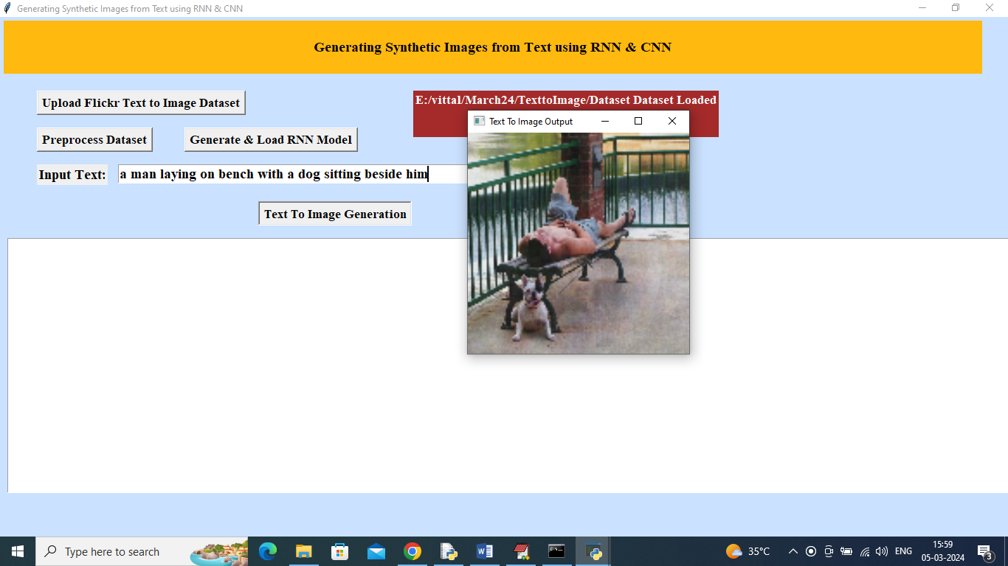

Slide 27
CONCLUSION
The text-to-image generation project has explored and implemented an advanced system that bridges the gap between textual descriptions and visual representations. By leveraging Recurrent Neural Networks (RNNs) for text embedding and Convolutional Neural Networks (CNNs) for image synthesis, the proposed system aims to enhance the quality and accuracy of synthetic image generation from text inputs.

Slide 28
FUTURE SCOPE:
Improving Text Comprehension Capabilities
Enhancing Image Realism
Expanding Multilingual Capabilities
Real-Time Processing and Application Integration
Ethical and Social Considerations
In conclusion, the future scope of text-to-image generation encompasses a range of exciting developments aimed at improving text comprehension, image realism, multilingual support, real-time processing, and addressing ethical considerations. Continued research and innovation in these areas will drive the advancement of text-to-image technologies and expand their potential applications in various fields.

Slide 29
REFERENCES:
Goodfellow, I., Pouget-Abadie, J., Mirza, M., Xu, B., Warde-Farley, D., Ozair, S., . . . & Bengio, Y. (2014). Generative Adversarial Nets. Advances in Neural Information Processing Systems (NeurIPS). Retrieved from https://arxiv.org/abs/1406.2661
Kingma, D. P., & Welling, M. (2014). Auto-Encoding Variational Bayes. International Conference on Learning Representations (ICLR). Retrieved from https://arxiv.org/abs/1312.6114
van den Oord, A., Vinyals, O., & distill, H. (2017). Neural Discrete Representation Learning. Advances in Neural Information Processing Systems (NeurIPS). Retrieved from https://arxiv.org/abs/1711.00937
Radford, A., Metz, L., & Chintala, S. (2016). Unsupervised Representation Learning with Deep Convolutional Generative Adversarial Networks. International Conference on Learning Representations (ICLR). Retrieved from https://arxiv.org/abs/1511.06434

Slide 30
GITHUB LINK:
https://github.com/manureddy0299/Generating_Synthetic_Images_from_Text_using_RNN

Slide 31
THANK YOU

